Slide 1
Protocol Design
What you probably don’t need to know

Slide 2

Who is this guy?

Slide 3


Slide 4
Who is this guy?
Custom TCP/IP communication with:
Automatic Guided Vehicles
Printing presses
Hot backup systems
GUI clients for factory automation systems
Bridge devices (TCP/IP to/from serial or unusual networks)
Oil pipeline inspection tools
Clients: GM, Syracuse News, Estee Lauder, RR Donnelley, Ricoh, BlueScope Steel. All 24x7 automated systems.

Slide 5
Meta

Slide 6
Scope
The first rule of TCP/IP socket communication: Don’t.
HTTP / WebSockets.
ASP.NET Core / SignalR.
TCP/IP sockets exist primarily for devices.
Generic protocols are complex and difficult to implement on constrained hardware. E.g., HTTP.
Even when they can be implemented, they’re inefficient. E.g., HTTP.
Goal: Implement (or fix!) TCP/IP socket protocols.

Slide 7
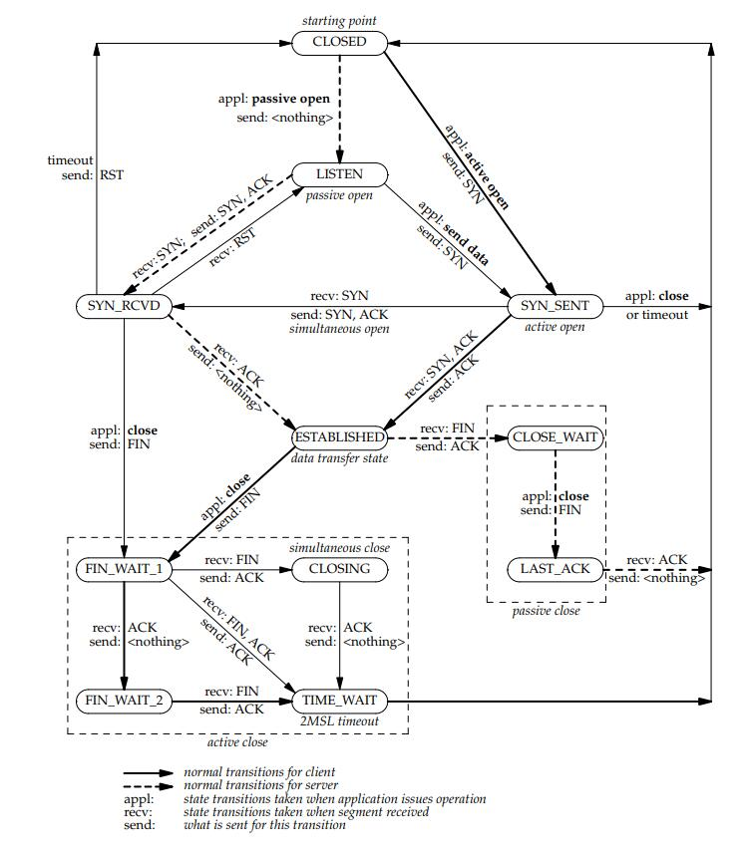

Out of Scope
UDP (mostly)
Packet details (FIN/ACK/RST):
TCP/IP Illustrated (Stevens), Volume 1
Also state diagram from Volume 2
E.g., TIME_WAIT
Notes:
This book has a 2nd edition, which has received mixed reviews. I haven’t read it.

Slide 8
Definition: “Application Protocol”
All communication above the TCP/IP layer for a given application.
E.g.: POP, SMTP, IMAP, FTP, SSH
“Custom Application Protocol” – the details of how your apps communicate.
Notes:
I tend to use this term to describe the structure of your application’s communication.
A lot of the example protocols can work over TCP or UDP, but are most commonly used with TCP.

Slide 9
TCP/IP Semantics
Notes:
Need to get some background on TCP/IP before we can discuss designing an application protocol for TCP/IP.
For sake of time, I’m going to cover common mistakes, not Everything About TCP/IP.

Slide 10
What TCP/IP Provides
“Connection” (but not whether a connection is viable)
Client connects to server.
Connected sockets don’t have an orientation.
Reliability
Acknowledgements, Checksums, Retransmission, Discarding duplicates.
If you send it, it will get there or you will receive an error.
Ordering
Packets sorted on receipt. You end up with an ordered stream of data.
Notes:
Also (doesn’t affect application protocol design):
Flow and congestion control
Adaptive timeouts
Nagle algorithm
Delayed ACKs

Slide 11
TCP/IP Abstraction: Connection
No “Known Connection State”
Corollary: These members are useless: Socket.Connected, TcpClient.Connected
Client
Server
SYN
ACK,SYN
ACK
Notes:
Once a connection is established, no packets flow across that connection!
Good: Routers can come and go. Later packets may take a completely different route.
Bad: Not a physical connection. Cannot know if the other side is “there”.
Therefore: “Connected” is meaningless. It is assumed to be true.

Slide 12
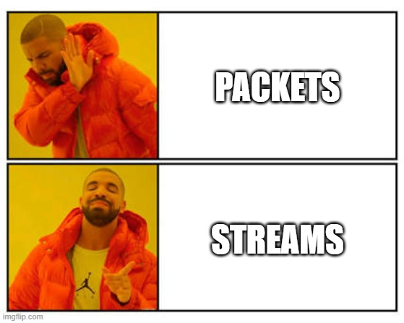
TCP/IP Abstraction: Stream
TCP/IP provides a stream of bytes, not a stream of packets.
There is no way to “send a packet” or “read a packet”.
Notes:
You cannot think in terms of packets; you have to think in terms of streams.

Slide 13
TCP/IP Abstraction: Stream
Actually two independent one-way streams: read and write.
Client
Client Write / Server Read
Server
Client Read / Server Write
Notes:
This is important for two reasons:
Can close one stream without the other. Rare, but is used in some protocols.
Each stream has its own buffer; if both sides write a lot without reading, they can deadlock.

Slide 14
TCP/IP API
Notes:
AKA: Tips for implementing your server/client.

Slide 15
Berkeley API
I generally prefer Berkeley/WinSock or low-level wrappers
I.e., Socket over TcpClient/TcpListener.
This lets you more easily apply lessons learned from any Berkeley system.
Any abstraction can introduce bugs, especially for unusual corner cases in complex systems.
However, .NET types are unusually good quality.
But ignore the UDP parts.
Remember: streams, not packets.
Documentation may talk about packets/datagrams. This does not apply to stream sockets.
Notes:
I have personally found bugs in:
VCL socket (precursor of .NET Socket)
MFC socket classes (multiple bugs, not reported)
Finding bugs in socket wrappers is really annoying.
Berkeley has one API for both UDP and TCP.

Slide 16
Berkeley API – Common Mistakes
Writes:
Complete when data is copied to the OS.
Successful write does not mean the other side got it. Or will ever get it.
Reads:
Complete when data arrives or there is an error.
Successful read does mean these bytes are the next ones in the stream.
Be aware a read-completion of 0 bytes is the normal way to detect EOS.
Notes:
(skipping Connect/Listen, which are pretty straightforward)

Slide 17
Designing Application Protocols for TCP/IP
Notes:
Finally!

Slide 18
Protocol Patterns
Stream-based
E.g., audio/video transmission, file transfer.
Message-based
Command/Response: one side sends Command; other side sends Response.
Can be bidirectional.
Poll/Status: a simple form of Command/Response.
Subscribe/Event: one side sends Subscribe/Unsubscribe; other side sends Event.
Notes:
Not mutually exclusive; one protocol may be partially command/response and partly subscribe/event.
FTP is an interesting blend!

Slide 19
Write It Down: Formal Specification
Even if it’s not “your” protocol.
Formal documentation:
MUST, MAY, and SHOULD from RFC 2119.
Build on established standards.
Clarify: bytes vs characters (encoding), endianness.
First contact:
Explicitly state which side is the server.
Notes:
“Build on established standards” E.g., Unicode standard has clear meanings for “character”, “code point”, and “encoding”.
“First Contact” After the connection is established, both sides look the same. However, to establish the connection, a client must connect to a server. 1-to-many does not necessarily mean the “1” side is the server. If you have a 1-to-1 scenario, then one side must be chosen as a server – sometimes it’s more natural to think of one side as a server, but other times it’s just a tossup. Peer-to-peer (many-to-many) scenarios often have all participants acting as both client and server.

Slide 20
Write It Down: Formal Specification
Choosing a port for the server
Configurable if possible.
IANA: 0-1023 is off limits; use 1024-49151.
Avoid ephemeral port conflicts:
IANA (modern OSes): 49152 to 65535
Old Linux/Windows: 1025-5000
Notes:
IANA: Internet Assigned Numbers Authority

Slide 21
Application Protocol Versioning
Enabling backwards compatibility is easier now than later!
The version to use should be negotiated, not assumed.
Don’t over-engineer; i.e., just have one side send a list and have the other side choose one.

Slide 22
What TCP/IP Provides (Review)
“Connection” (but not whether a connection is viable)
Client connects to server.
Connected sockets don’t have an orientation.
Reliability
Acknowledgements, Checksums, Retransmission, Discarding duplicates.
Ordering
Packets sorted on receipt
Notes:
The key to designing correct protocols is working around what TCP/IP does not provide.

Slide 23
What TCP/IP Does NOT Provide
Message Boundaries
Your abstraction is a stream of bytes, not packets.
Known Connection State
You cannot know whether a connection is viable.
Notes:
Most of the work designing application protocols is dealing with these two aspects.

Slide 24
Designing Application Protocols for TCP/IP: The Two Tricky Bits
Notes:
Finally!

Slide 25

Message Boundaries: Problem
Most protocols have some notion of a “message”, e.g., Command, Response, (Un)Subscribe, Event.
TCP does not preserve message boundaries.
Stream of bytes, not packets.
“Send”: place bytes in outgoing stream.
“Receive”: read bytes from incoming stream.
“Send” and “Receive” are not 1:1.
1:N or N:1 or even M:N!
Loopback testing implies 1:1
Notes:
True story: I once worked for a company that developed custom client/server software. The original communications code had made this common mistake. However, they were all on dedicated networks with high-end hardware, so the underlying problem only happened very rarely. When it did, the operators would just chalk it up to "that buggy Windows OS" or "another network glitch" and reboot. One of my tasks at this company was to change the communication to include a lot more information; of course, this caused the problem to manifest regularly, and the entire application protocol had to be changed to fix it. The truly amazing thing is that this software had been used in countless 24x7 automation systems for 20 years; it was fundamentally broken and no one noticed.

Slide 26
Client
Server
CD
AB
OS
OS
ABCD

Slide 27
Message Boundaries: Solutions
“Message Framing”
Length Prefixing:
Binary number indicating length of message.
Document: length and endianness.
Delimiters:
May require escaping message data to avoid delimiters.
Requires flexible buffers on receiving side.
Notes:
Implementation reminder: your length prefix buffer can be split, too!

Slide 28

Connection State: Problem
TCP is an “idle protocol”:
No packets are transferred when idle.
TCP will detect a dropped connection if data is sent.
Reliability guaranteed!
Most protocols only have one side sending at a time; the sending side sees an error – the receiving side is half-open.
Windows detects local network link loss and notifies apps!
Notes:
Google tip: “Half-open” is not the same as “half-closed”.
Rarely seen in test environments but common in the real world.

Slide 29
Avoiding Windows’ Helpfulness
You can’t just unplug the network cable.
You have to unplug a network cable not connected to your client or server.
Client
Server
router
router

Slide 30
Connection State: Solution
Wrong solutions: ping, second connection.
Correct solution:
Periodic noop message (“ping” / “heartbeat” / “keepalive”)
TCP has a “keepalive” option, but:
Stack support, router support, 2 hours, systemwide settings.
Periodic sends must be done on both sides.
If you can’t (i.e., it’s not your protocol), then you have to use an idle timer.
Notes:
True Story: I once had to write software to control a serial device that operated through a "bridge" device that exposed the serial port over TCP/IP. The company that developed the bridge implemented a simple protocol: they listened for a single TCP/IP connection (from anywhere), and - once the connection was established - sent any data received from the TCP/IP connection to the serial port, and any data received from the serial port to the TCP/IP connection. Of course, they only allowed one TCP/IP connection (otherwise, there could be contention over the serial port), so other connections were refused as long as there was an established connection.
The problem? No keepalives. If the bridge ever ended up in a half-open situation, it would never recover; any connection requests would be rejected because the bridge would believe the original connection was still active. The bridge failed during our prototyping; when we brought the root cause to the other company's attention, they were unable to implement a keepalive (the embedded TCP/IP stack didn't support it), so they worked with us in developing a method of remotely resetting the bridge.
It's important to note that we did have keepalive testing on our side of the connection (via a timer), but this was insufficient. It is necessary to have keepalive testing on both sides of the connection.

Slide 31
History Lesson: HTTP

Slide 32
History of HTTP
HTTP 1.0 (1989-1996)
One connection per request (3-way, req, resp, 4-way)
Text-based
Headers added for flexibility: Headers and Body (\n\n)
Header might specify body length (Content-Length)
Implementation:
Requires very flexible buffering.
Also requires an idle timer to detect idle connections.
Very inefficient. Impossible for some devices.

Slide 33
History of HTTP
HTTP 1.1 (1997)
Connections can be reused, plus pipelined requests.
Still text-based
Still super flexible: Headers and Body
Header might specify body length (Content-Length)
Implementation:
Still requires very flexible buffering.
Still requires an idle timer to detect idle connections.
Slightly more efficient. Still impossible for some devices.

Slide 34
History of HTTP
HTTP 2 (2015)
Multiplexing: multiple simultaneous bidirectional requests.
Still one TCP/IP stream, though, so has head-of-line issues.
Binary
Content-Length is optional but binary.
Ping message to detect idle connections.
Implementation:
Only requires flexible buffering if Content-Length is missing.
Much more efficient. Possible for more devices.

Slide 35
History of HTTP
HTTP 3 (2022)
Multiplexing: multiple simultaneous bidirectional requests.
Truly independent streams!
Based on UDP (QUIC)
Ping message to detect idle connections (and keep UDP forwarding working).
Implementation:
Most efficient.
QUIC support currently isn’t available for many embedded systems.

Slide 36
The Future Is QUIC
QUIC is more than just HTTP/3!
SMB
DNS
Syncthing
MQTT
(your protocol here)

Slide 37
Tips

Slide 38
Error Handling
All errors should close the connection.
Delay for some time before retrying.
Allow abortive close.
If you’re done communicating and you were about to close the connection anyway, then ignore any errors.
Keep a continuous read operation to detect errors.
Writes complete successfully when data is copied to OS.

Slide 39
Logging
Have some way to log everything, from day 1.
Notes:
Even if you don’t need it for debugging, you’ll need it to debug other people’s devices.

Slide 40
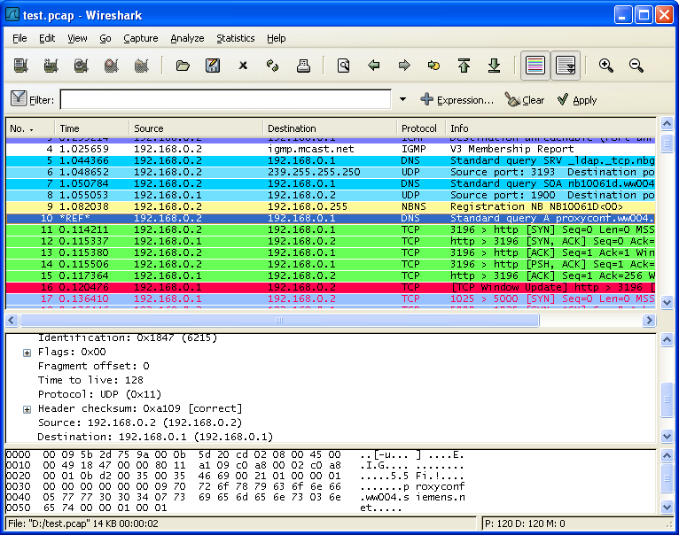
Inspection Tools: Wireshark
If you need Wireshark, also get TCP/IP Protocols Volume 1 (Stevens).

Slide 41
Testing Tools: Clumsy
Alternatives:
TMNetSim
dummynet

Slide 42
Don’t Use UDP
Sometimes devs think “I don’t want to do message framing; I want to send and receive packets. That’s easier.” But it’s not.
UDP is primitive compared to TCP/IP:
Unreliable packet delivery.
Unreliable packet order.
Message size limited to Path MTU.
No Path MTU discovery (and fragmented packets are usually dropped).
Routers are less friendly to UDP, particularly NAT.
Subject to IP spoofing (MITM attacks).

Slide 43
TL;DL
Notes:
Too long; didn’t listen

Slide 44
The Future Is QUIC
Over the last 50 years (!), OS vendors have (re-)written many TCP/IP stacks many times, adjusting:
Flow control (e.g., sliding window)
Congestion control (e.g., slow start)
Efficiency (e.g., Nagle algorithm, delayed ack)
Reliability (e.g., retries)
Path MTU discovery
QUIC takes all the best algorithms developed for TCP/IP and implements them in user space over UDP.
You get all of the benefits of higher-level TCP-like abstractions with most of the efficiency of UDP!

Slide 45
The Key Information (TCP and QUIC)
Design:
Write the protocol down in a formal document.
Message framing.
Implementation:
Always be reading
Detect errors ASAP.
Periodically write
Detect half-open connections.
Use asynchronous APIs for production servers
Thread per connection (or 2!) doesn’t scale.

Slide 46
Demo: Custom TCP/IP Protocol
https://tinyurl.com/async-tcp
Uses:
Asynchronous TCP/IP Socket APIs.
System.IO.Pipelines for buffer management.
System.Threading.Channels for queueing.
Demonstrates:
Length-prefix message framing.
Keepalives.
Request/response association and higher-level APIs (e.g., HttpClient.GetAsync).
Connection management.

Slide 47
Q&A Time!

